Slide 1


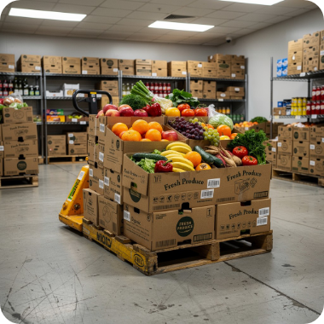
DIWA2110 • WEB APPLICATION DEVELOPMENT
Full-Stack Academic Project
Enterprise Distribution Platform
Batlounge Fruits
Distribution Management System
A modern web architecture streamlining supply chain workflows, inventory configuration, and multi-tier order tracking.
React + Express + MySQL
JWT Authentication
Automated Stock Deduction

Slide 2





Operational Pain Points
The Legacy Business Challenge
Manual paper-based processes created critical bottlenecks in daily inventory & sales workflows.
Manual Logbooks
Supplier Tracking
SKU Ambiguity
Inaccurate Totals
Blind Spots
Unstructured paper logs for stock intake and purchasing leading to lost data.
Zero centralized visibility over supplier geographic origin and regional coverage.
Inability to differentiate fruit varieties by specific box-size configurations.
Calculation errors across order line items and real-time inventory balances.
No executive oversight into outstanding vendor fulfillment and revenue streams.

Slide 3
MODERN ARCHITECTURE
The Proposed Full-Stack Solution
Centralized Database Core
TECHNOLOGY STACK
Relational MySQL database managing complex entity mappings between suppliers, box variants, and order fulfillment states.
Frontend UI
React SPA
API Gateway
Express.js / Node.js
Automated Inventory Control
Strict business logic maintaining real-time stock levels upon order creation, status transitions, and cancellations.
Relational Engine
MySQL RDBMS
End-to-End Workflow Visibility
Security Layer
JWT + RBAC
Role-specific dashboards providing instant operational analytics across vendors, provinces, and historical sales trends.
Single-page reactive architecture for real-time logistics.

Slide 4


ACCESS CONTROL ARCHITECTURE
User Roles & Security Framework
Administrator Role
Sales Representative
Full Master Control Access
Operational Order Executions
Master Data: Manage suppliers, fruits, and box sizes
Vendor Register: Create & update registered vendor profiles
Stock Management: Full access to stock replenishment
Order Entry: Generate new purchase requests for vendors
Order Oversight: Process, approve, or cancel orders
Stock Search: Query available catalog & real-time inventory
Reporting Engine: Access system-wide analytical reports
Restricted: Excluded from system configuration
JWT Auth Safeguard:
Stateless HTTP headers with backend role authorization middleware protecting API routes.

Slide 5
TECHNICAL INFRASTRUCTURE
Three-Tier Application Architecture
TIER 1
TIER 2
TIER 3
Presentation Tier
Application Tier
Data Tier
React Single Page Application
Express.js / Node.js Server
Relational MySQL Instance
• Dynamic UI state management
• RESTful API endpoint controllers
• Normalized database schema
• Axios HTTP REST communications
• JWT security middleware
• Referential foreign key integrity
• Client-side form validation
• SQL transaction management
• ACID compliant order transactions
• Responsive dashboard widgets
• Business rule validation layer
• Query optimization & indexing
User Browser Engine
Node Execution Runtime
MySQL Database Server

Slide 6
DATA MODEL & SCHEMA
Relational Schema Architecture
CORE MODELING INNOVATION
Suppliers
Fruits & Box Sizes
Unique Product SKU Design
Stores vendor profiles, contact details, and province affiliations.
Master lookup entities defining raw fruit types and packaging specs.
A standalone product is defined exclusively by the combination of:
Purchases & Stock
Orders & Items
Fruit Type + Box Size Configuration
Inbound stock log linked to specific supplier transactions.
Outbound orders with itemized quantity breakdown & totals.
Prevents inventory confusion and standardizes unit pricing across all orders.

Slide 7

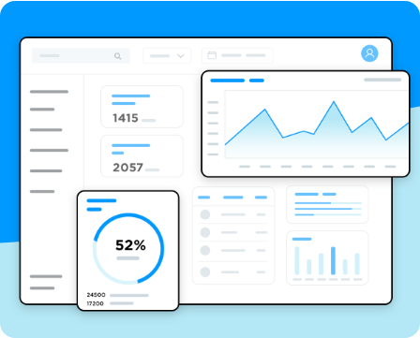
USER EXPERIENCE & UI
Core Application Modules
1. Authentication
2. Dashboard
3. Catalogue
Secure Login Modal
Real-Time Metrics
Products & Sizes
4. Suppliers
5. Stock
6. Vendors
Vendor Intake Management
Inventory Adjustments
Active Accounts
7. Orders
8. Order Details
9. Reports
Dispatch Management
Line Item Inspection
Executive Analytics

Slide 8




SYSTEM INTEGRITY & LOGIC
Core Business Rules & Enforcements
Active Vendor Validation
Positive Quantities & Pricing
Orders can strictly be submitted for active, registered vendors in the system.
Form inputs enforce positive numeric constraints for price and box quantities.
Stock Availability Verification
Automated Deduction & Restock
System blocks order creation if requested box quantities exceed available warehouse stock.
Inventory auto-deducts upon completion and restores instantly if an order is cancelled.
ACID Compliance: MySQL database transactions rollback state changes if any sub-operation fails.

Slide 9

BUSINESS VALUE
Executive Reporting & Insights
Top-Selling Fruits & Box Sizes
Demand Insight
Identifies high-velocity inventory to optimize procurement.
Regional Province Performance
Regional Analytics
Tracks distribution density and supplier coverage geographically.
Data-Driven ROI
Replaces guesswork with real-time MySQL aggregates to reduce stock shrinkage and maximize vendor turnover.
Pending Fulfillment Tracking
Operations
Monitors outstanding orders to prevent delivery delays.
100%
Sales Volume by Date Range
Workflow Visibility
Provides clear historical revenue trends for decision makers.
Revenue Audit

Slide 10

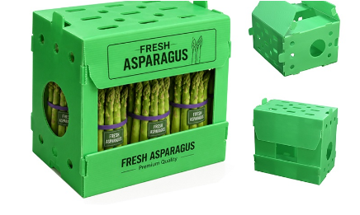

Project Summary
Full-Stack Operational Excellence
Secure & Responsive
JWT security combined with a fast React SPA frontend ensures a robust user experience across devices.
Validated Transaction Logic
Express API layer enforces stock limits, prevents negative inputs, and auto-syncs inventory on order states.
Business Problem Solved
Eliminates manual errors and provides Batlounge Fruits with immediate oversight of suppliers, orders, and sales performance.
Batlounge Fruits Distribution Management System • DIWA2110
Thank You

Slide 11



Image Sources
https://images.stockcake.com/public/c/c/d/ccd58d10-32c1-4ee6-96be-94efe9f1ea3b/fresh-produce-delivery-stockcake.jpg
Source: stockcake.com
https://www.justinmind.com/wp-content/uploads/2018/12/6-best-practices-for-Dashboard-Design-Justinmind-header.png
Source: www.justinmind.com
https://rulowin.com/wp-content/uploads/2026/07/PP-fruit-box-vegetable-box-54.jpg
Source: rulowin.com

